Slide 1
Unit 3: Frequency Domain Analysis
Polar plot

Slide 2
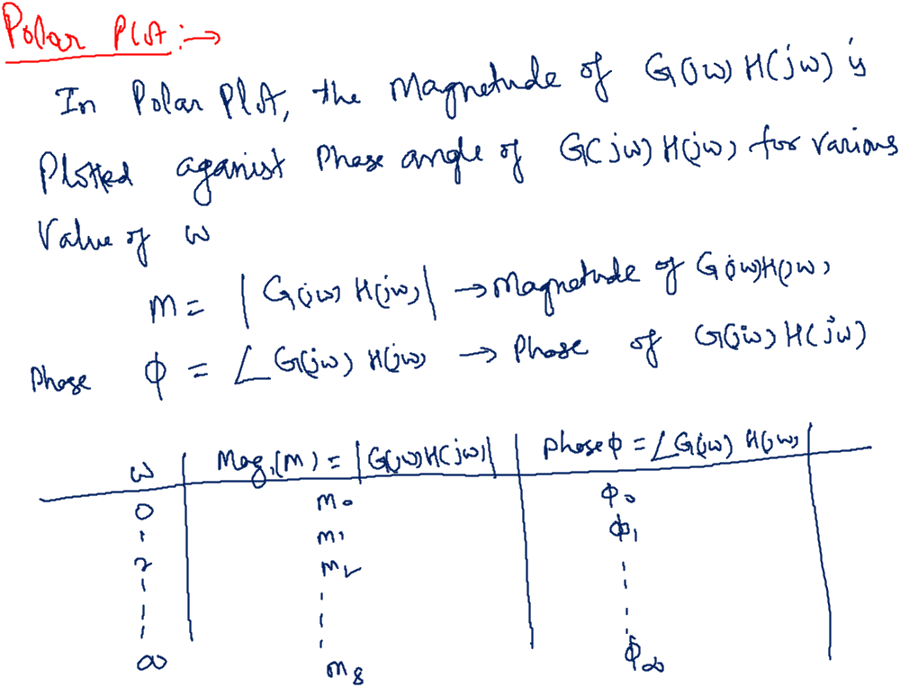

Slide 3
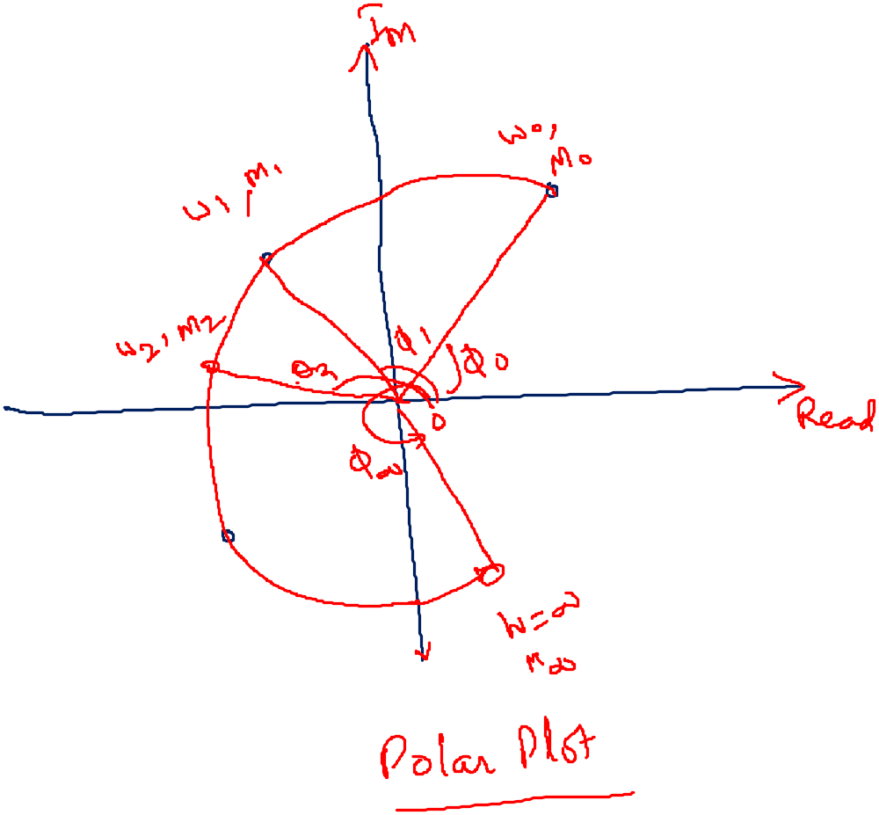

Slide 4
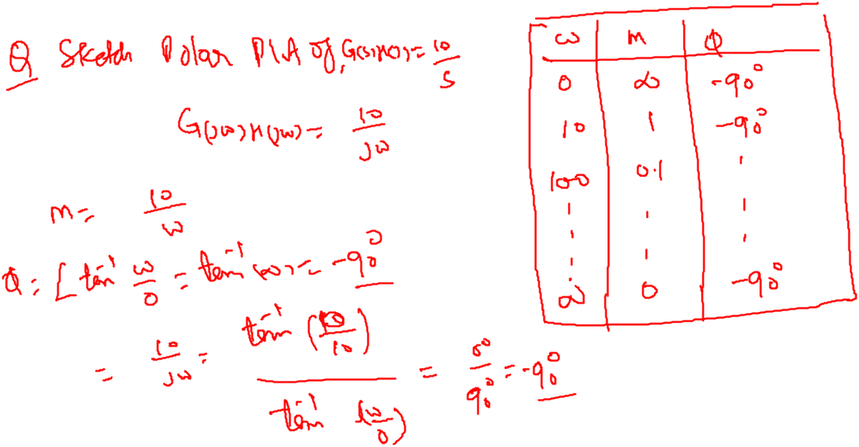

Slide 5
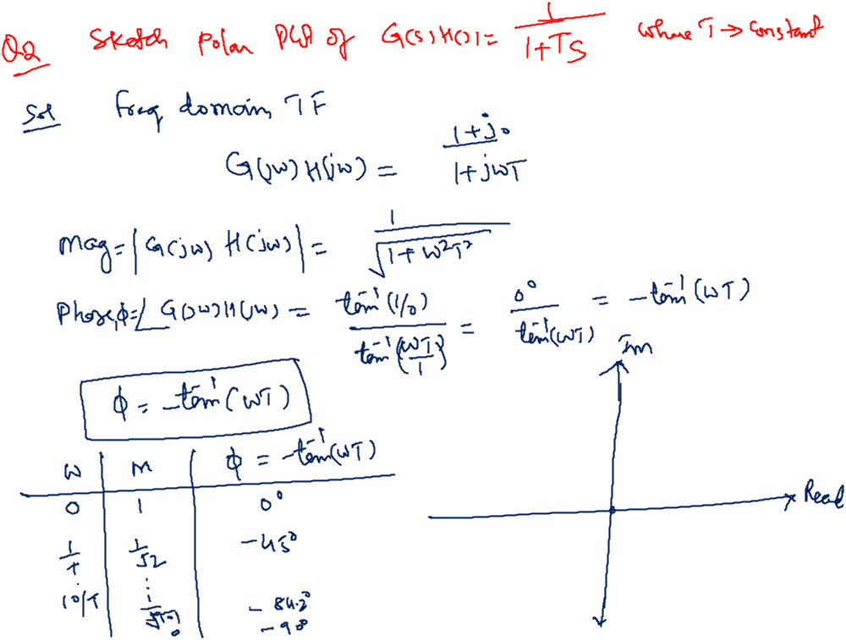
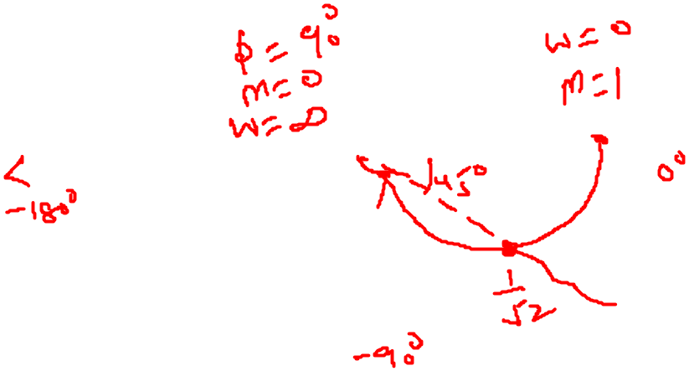

Slide 6
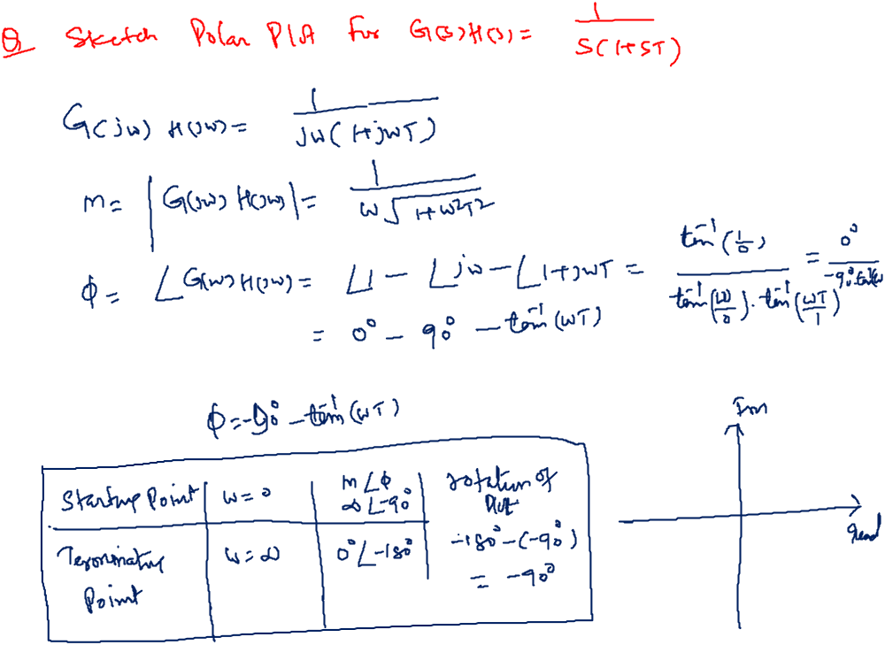
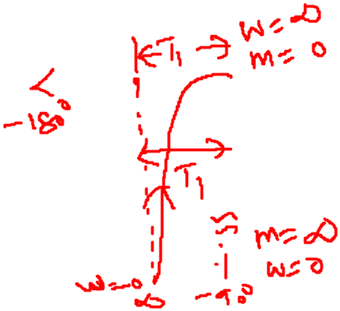

Slide 7
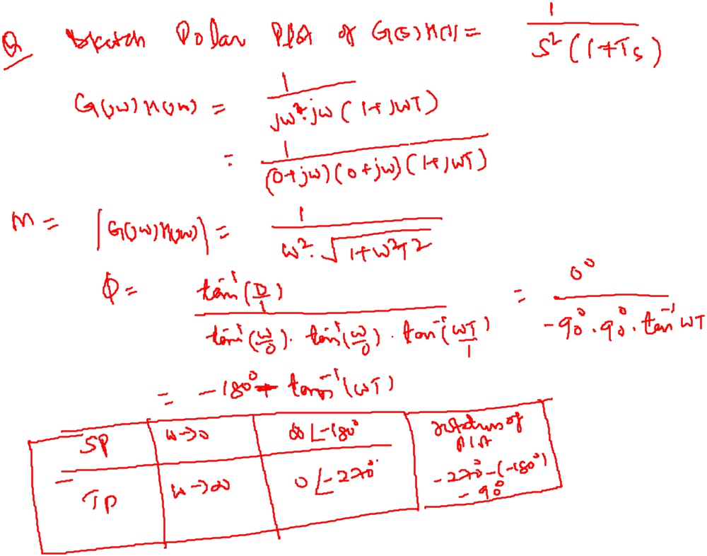
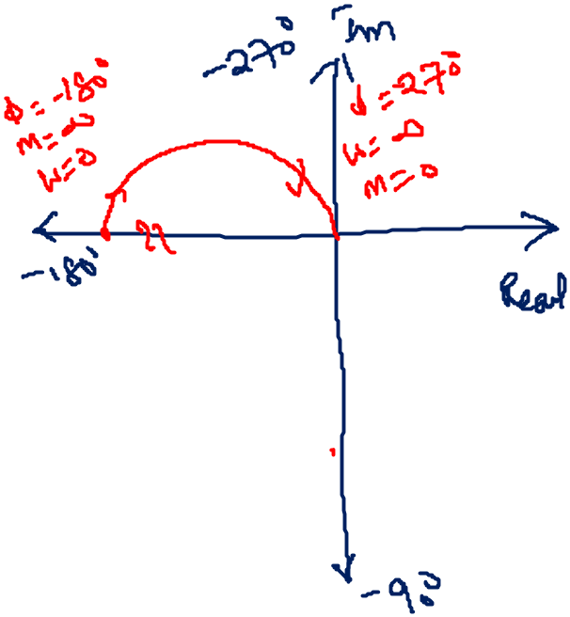

Slide 8
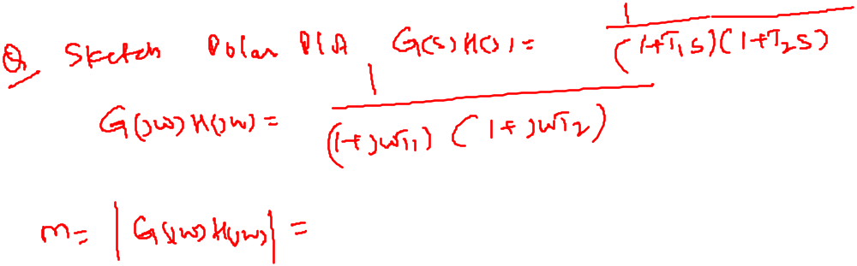
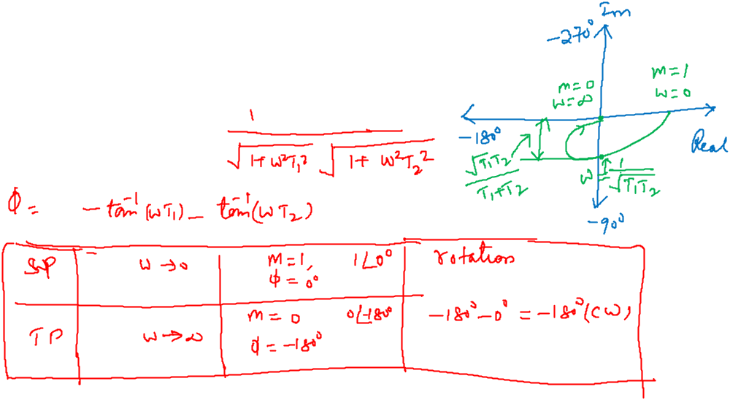

Slide 9
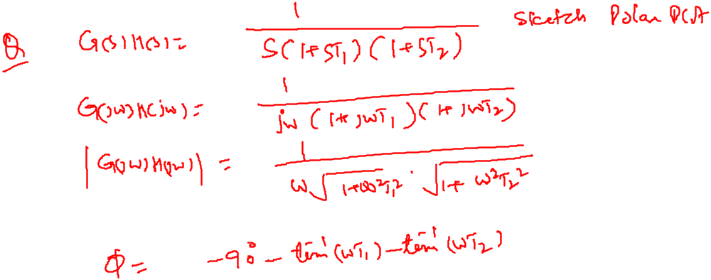
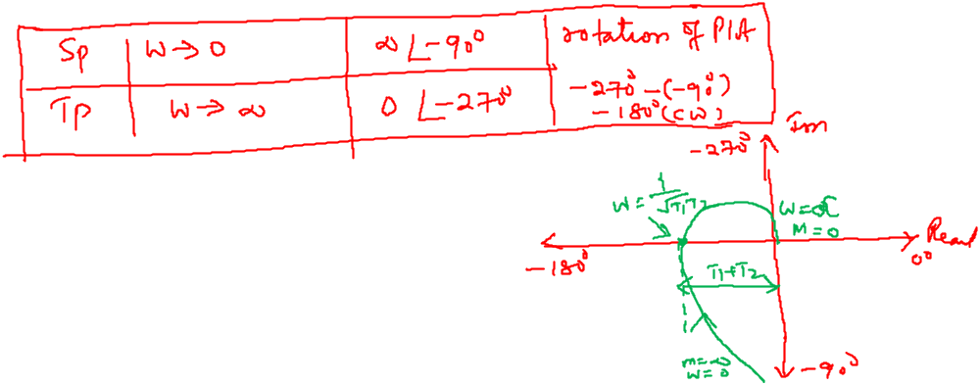

Slide 10
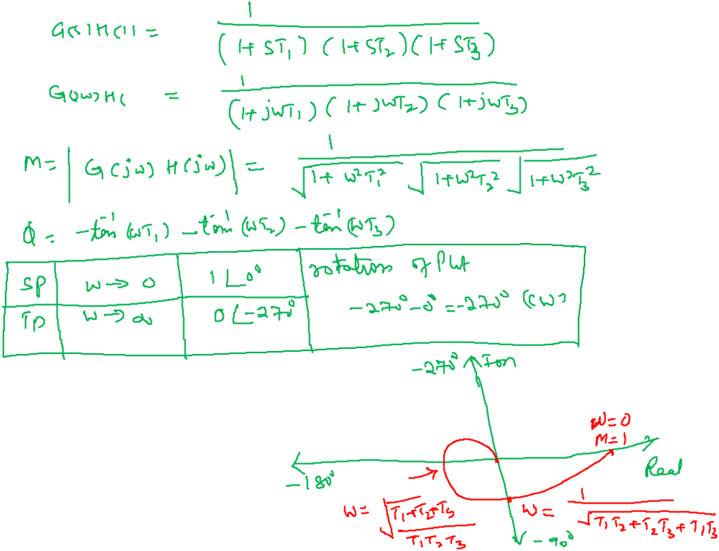

Slide 11
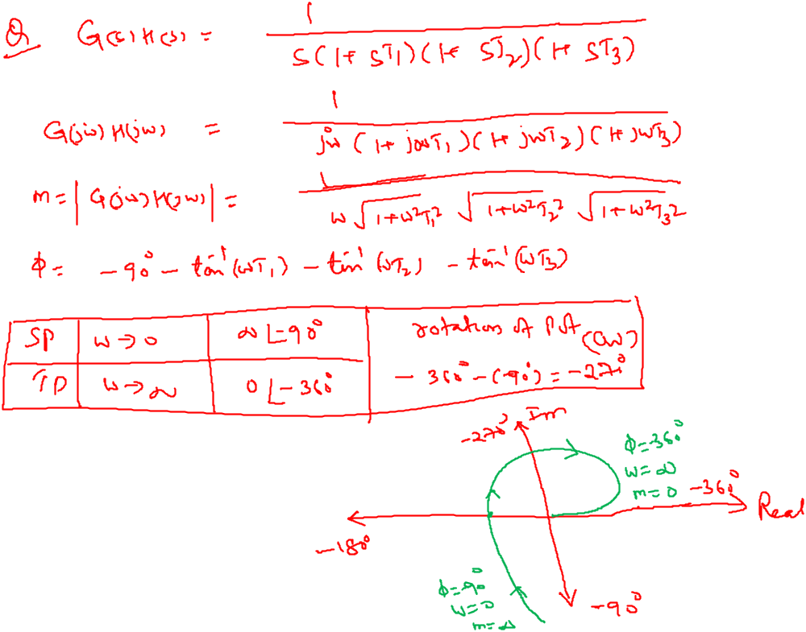

Slide 12
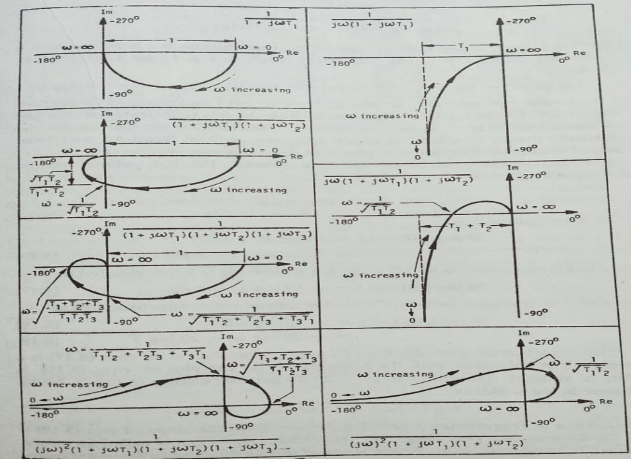
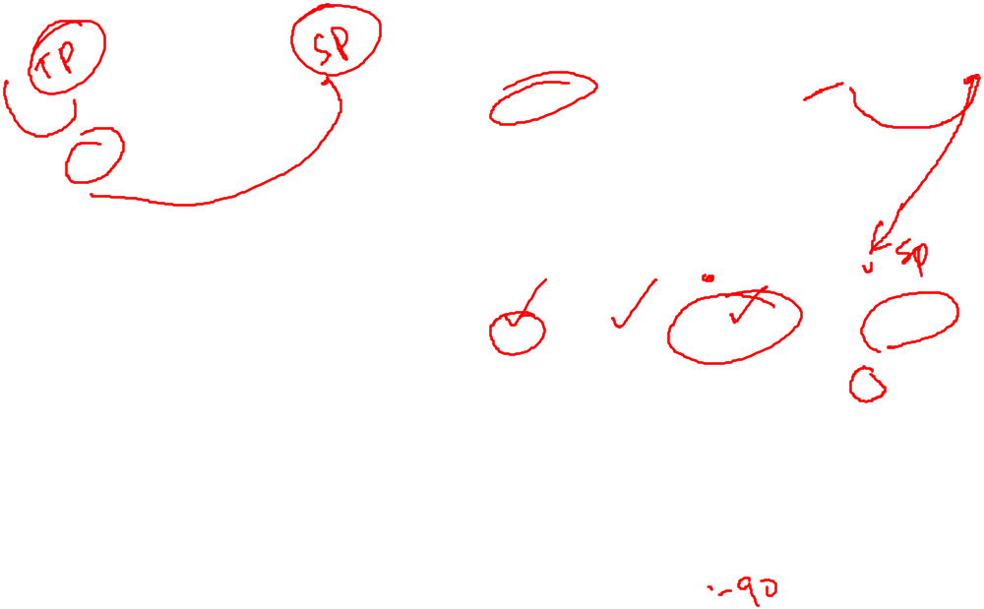

Slide 13
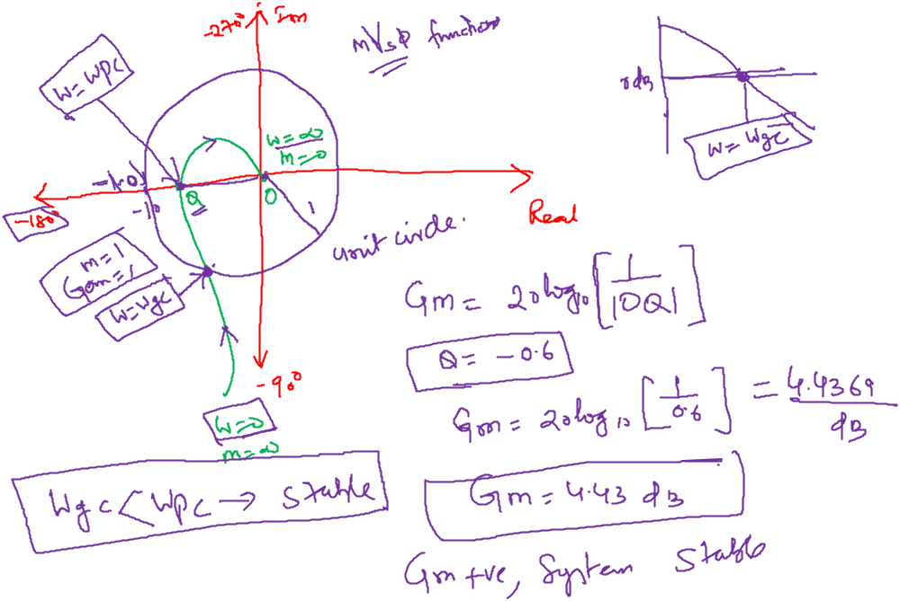

Slide 14
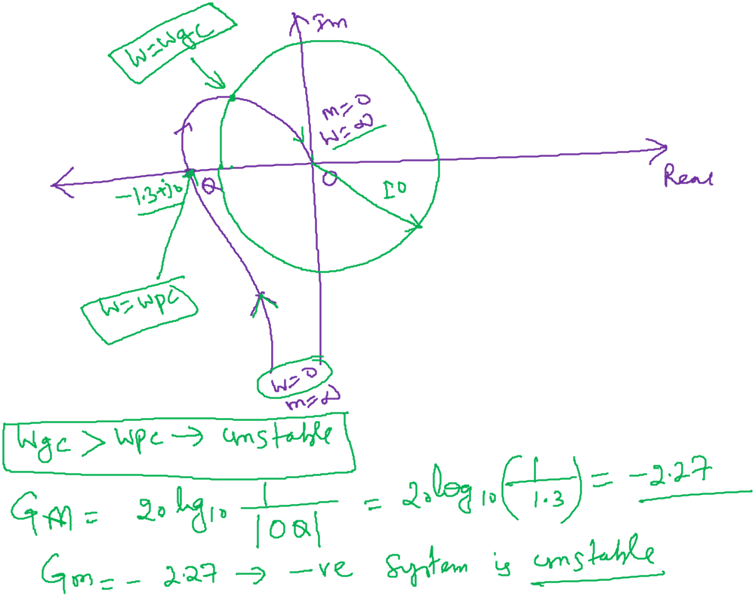

Slide 15
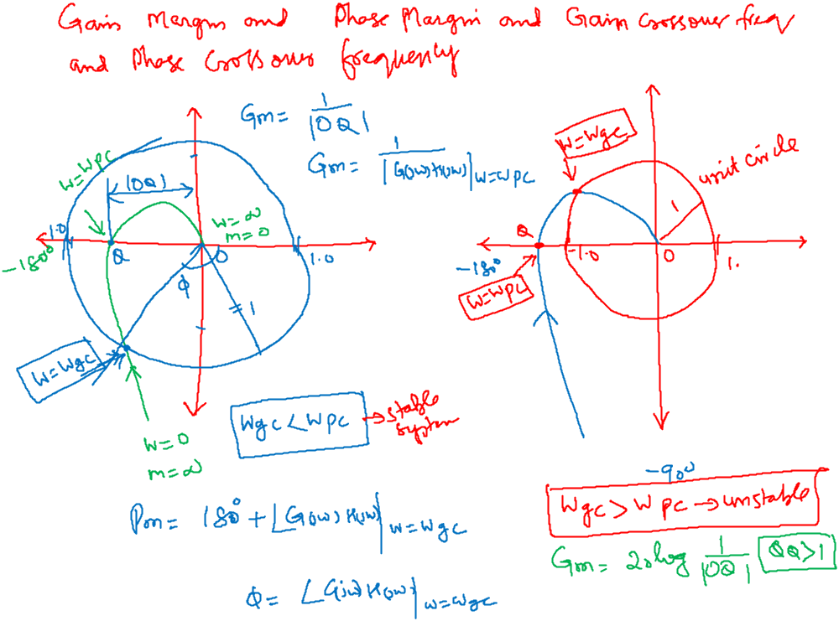

Slide 16
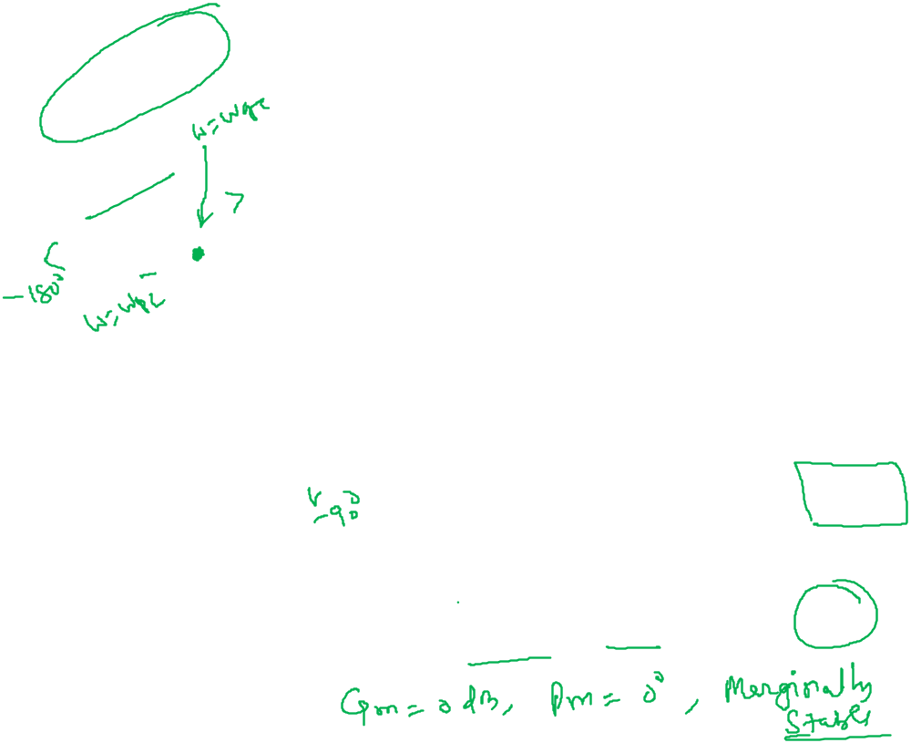
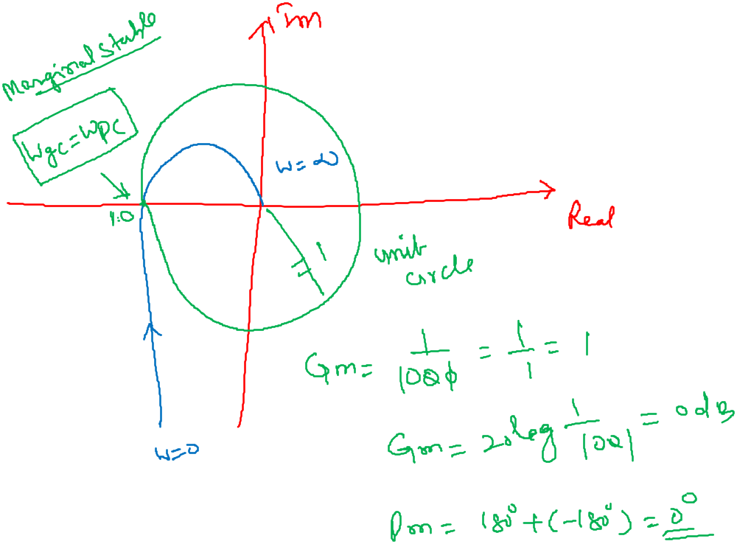

Slide 17
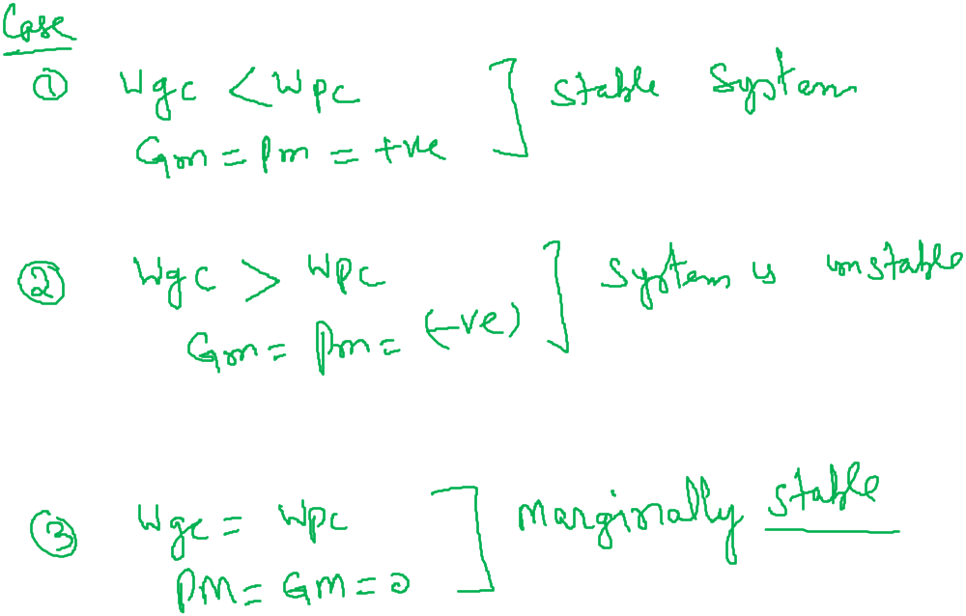

Slide 18
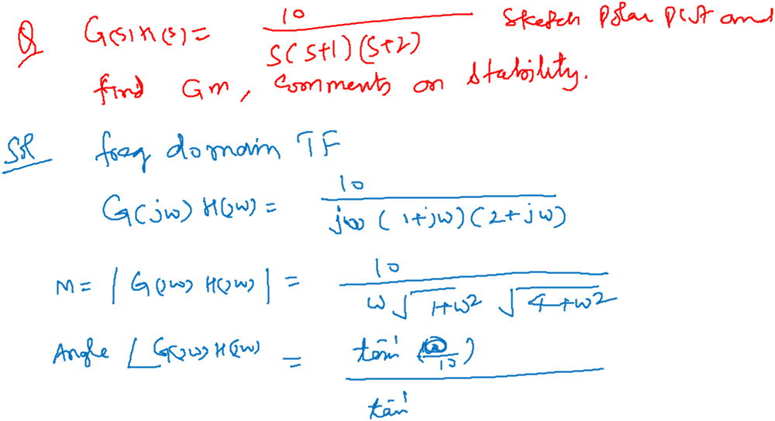
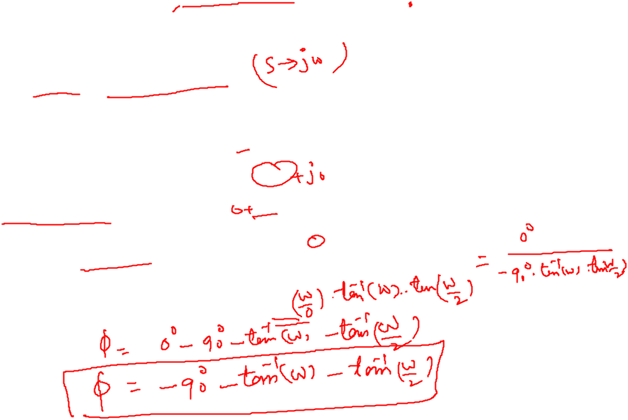

Slide 19
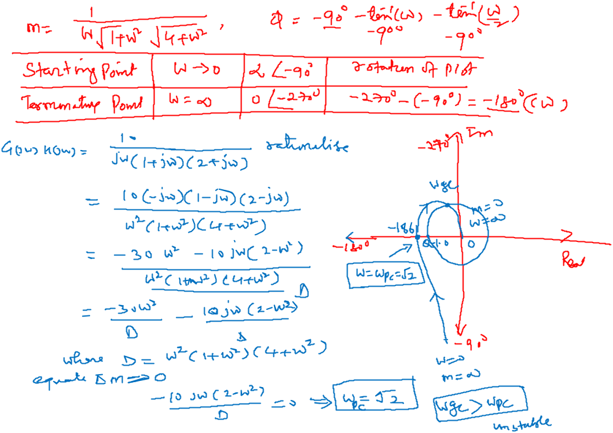

Slide 20
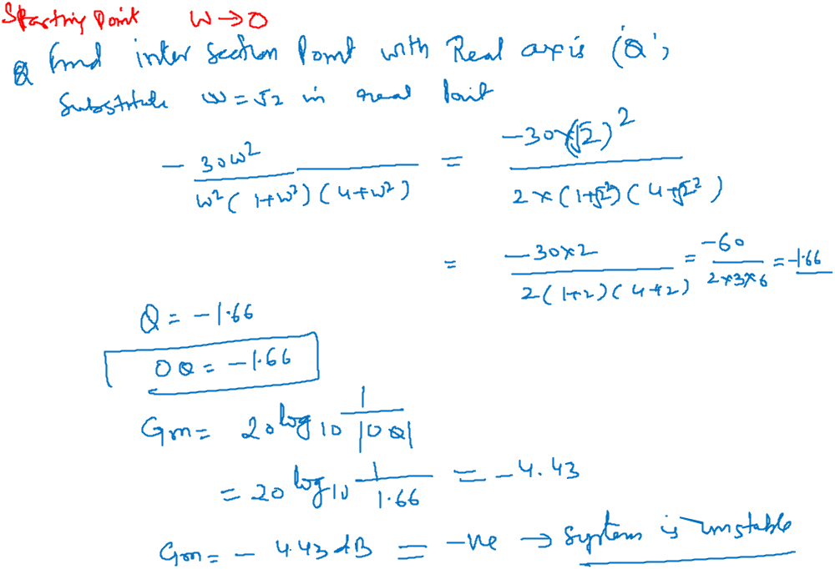

Slide 21
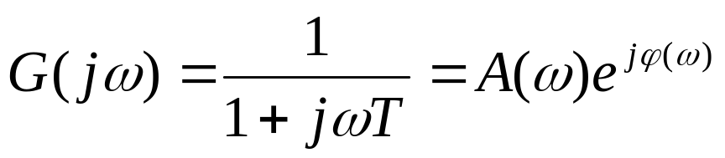
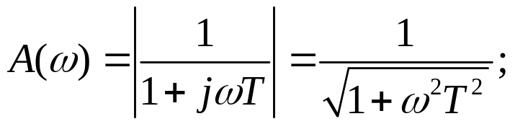
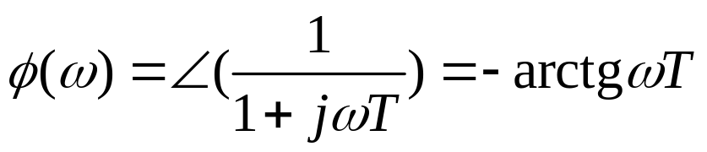


Definition：Frequency response (or characteristic) is the ratio of the complex vector of the steady-state output versus sinusoidal input for a linear system.
Magnitude response
Phase response
The output has same magnitude and phase with input
Magnitude will be attenuated and phase lag is increased.

Slide 22
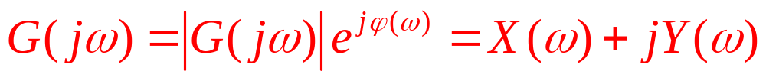
Nyquist Diagram
Magnitude characteristic diagram
A-ω plot
Phase characteristic diagram
ϕ-ω plot
Gain-phase characteristic diagram
Bode diagram
Nyquist diagram
Polar form or algebraic form: A and ϕ define a vector for a particular frequency ω.

Slide 23
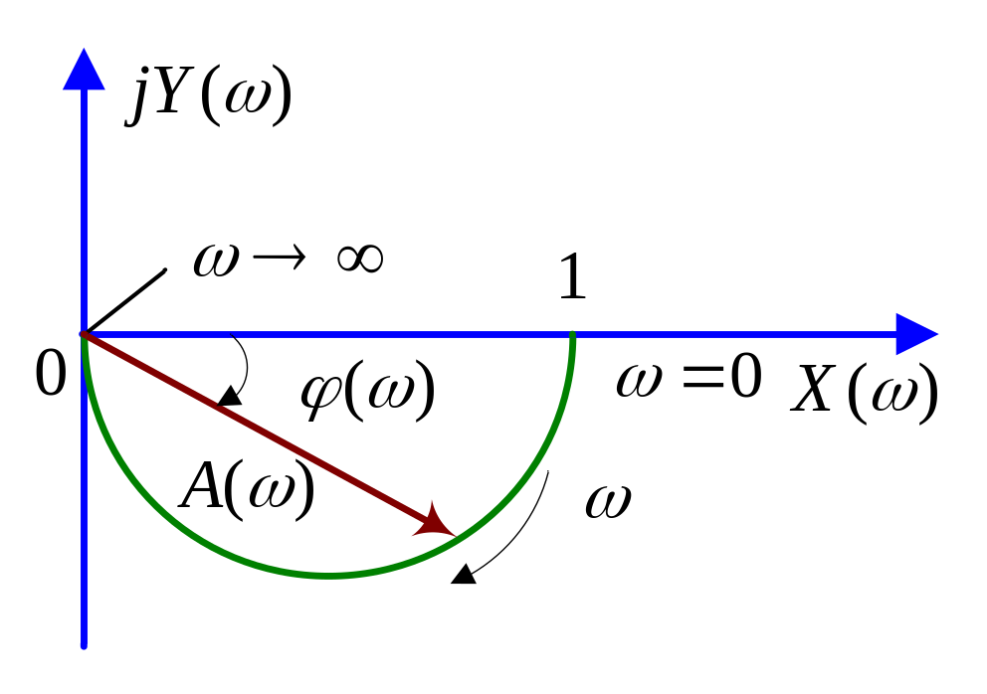
ω | 0 | 1/(2τ) | 1/τ | 2/τ | 3/τ | 4/τ | 5/τ | ∞
A(ω) | 1 | 0.89 | 0.707 | 0.45 | 0.32 | 0.24 | 0.2 | 0
ϕ(ω) | 0 | -26.6 | -45 | -63.5 | -71.5 | -76 | -78.7 | -90
Nyquist Diagram of RC Circuit

